Slide 1
NYC Taxi Trip Analysis
The Spark Way
Matthew Wang
Zefeng Zhang
Keyang Zhang

Slide 2
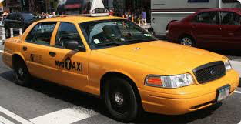
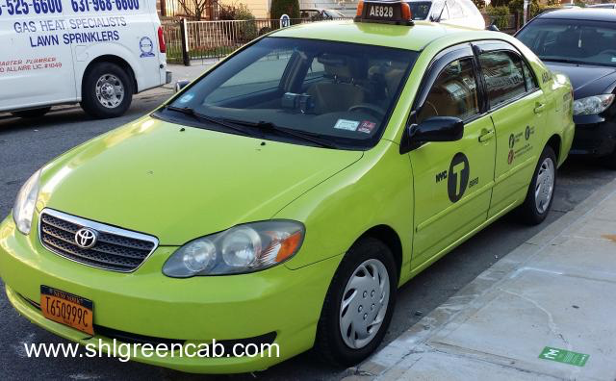
NYC Taxi Data
10 GB data from NYC open data
6 months from Jan 2016 through June 2016
Over 60 million taxi trips
Both yellow and green taxi

Slide 3
Analytics Goals
What are the top 10 pickup locations to the Kennedy/ LaGuardia airports?
What is the average taxi trip time?
How much longer on average will the trip take in the rush hour?
Pickup district heat map.

Slide 4
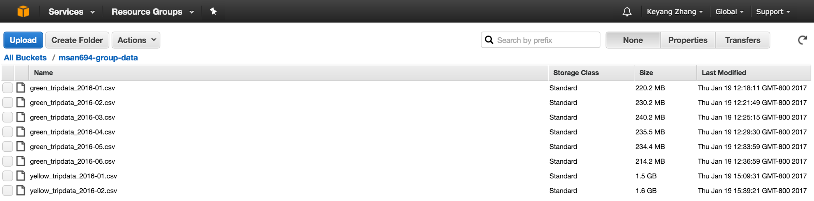
NYC Taxi Dataset
Time
pickup time, dropoff time
Location
Pickup/dropoff longitude/latitude
3. Distance/fare
Detect anomalies
4. NYC neighborhoods

Slide 5
Feature Engineering
Pickup/dropoff time:
Rush-hour trips
Trip duration
Longitude/latitude &
NY neighborhoods:
Pickup districts
Trips to Kennedy/ LaGuardia airports

Slide 6
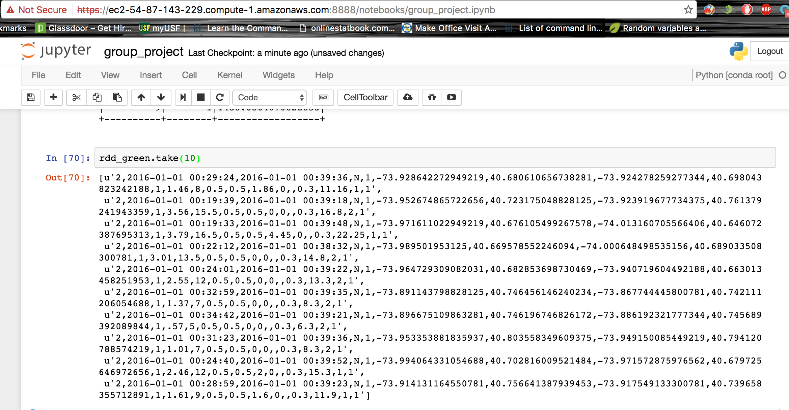
RDD Creation

Slide 7
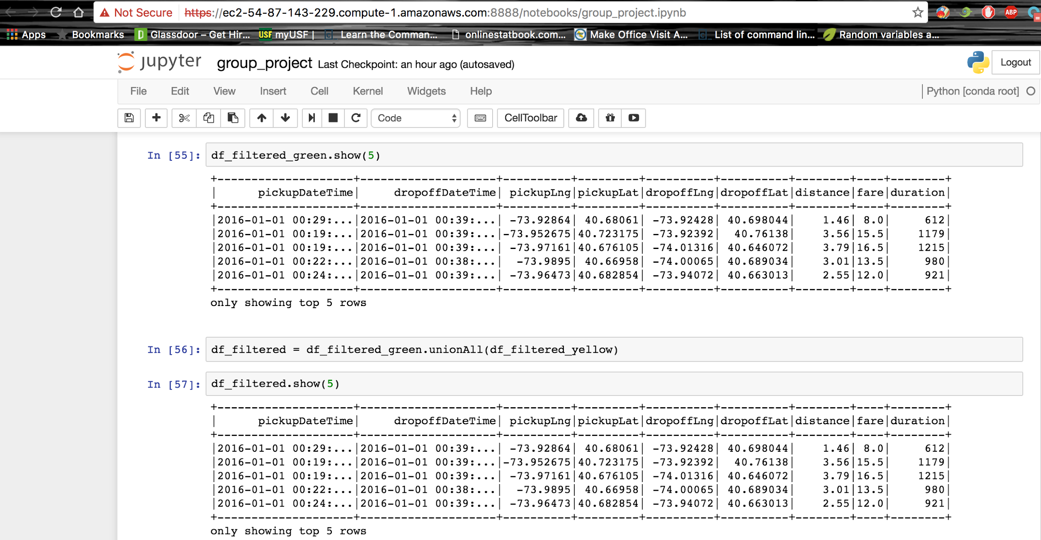
DataFrame Creation

Slide 8
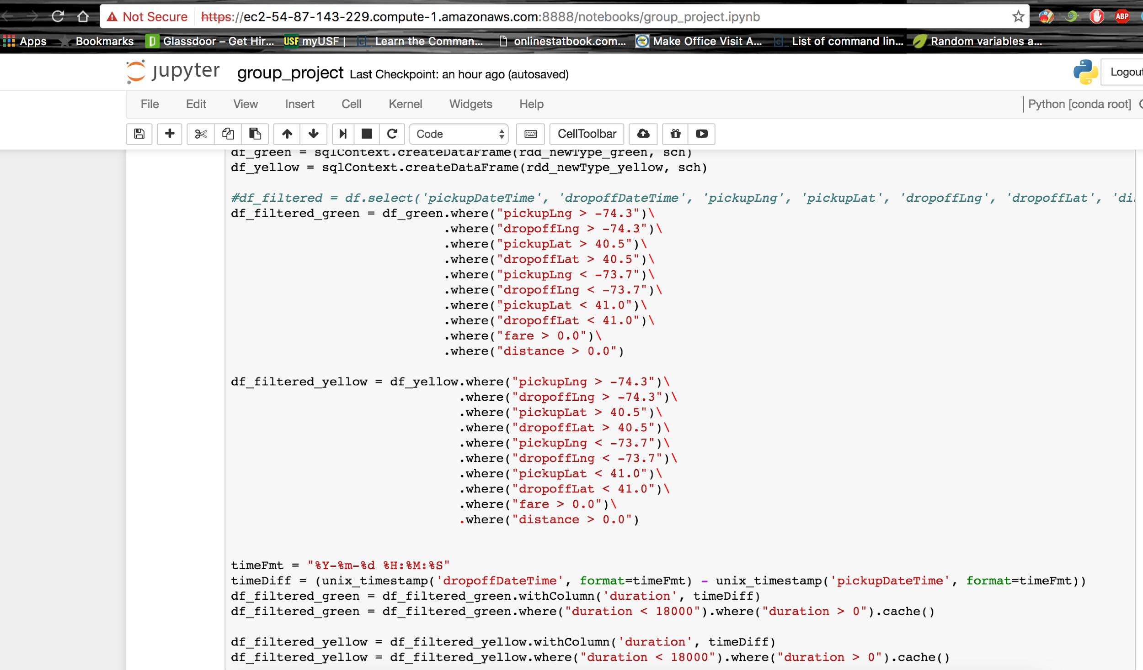
SPARK SQL

Slide 9
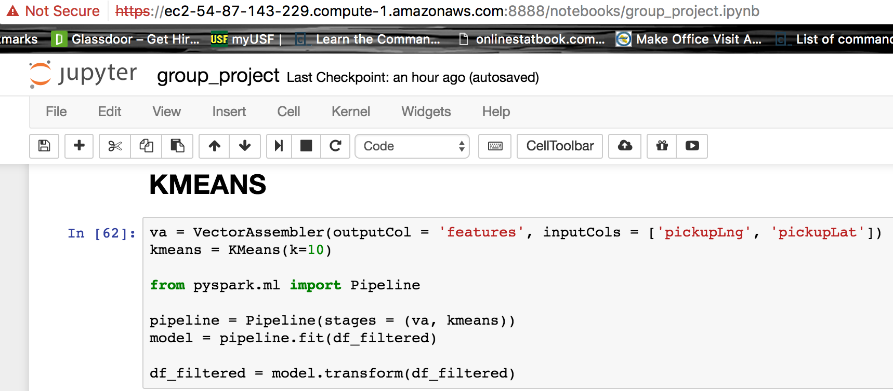
Machine Learning

Slide 10
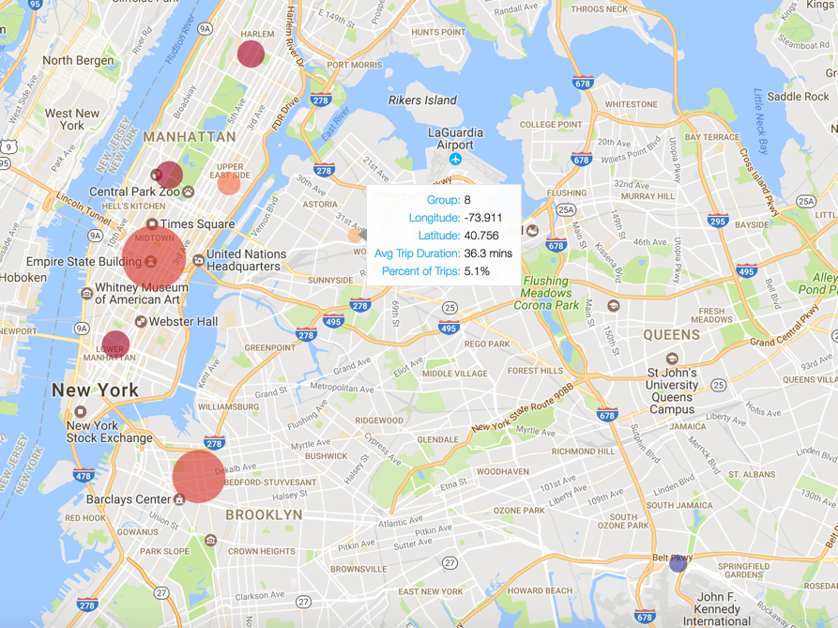
Pickup Centers for JFK in Rush Hours

Slide 11
Trip Time to Airports
 | Centers | 1 | 2 | 3 | 4 | 5 | 6 | 7 | 8 | 9 | 10
JFK | Rush | 37 | 44 | 44 | 15 | 33 | 43 | 34 | 34 | 45 | 41
 | Non-Rush | 28 | 36 | 32 | 14 | 24 | 32 | 30 | 29 | 39 | 31
 | Diff | 33% | 21% | 37% | 9% | 35% | 38% | 15% | 16% | 14% | 32%
LGA | Rush | 21 | 25 | 30 | 15 | 12 | 22 | 11 | 36 | 37 | 23
 | Non-Rush | 24 | 24 | 22 | 15 | 9 | 18 | 10 | 28 | 23 | 18
 | Diff | -13% | 4% | 39% | -3% | 34% | 24% | 11% | 27% | 59% | 29%

Slide 12
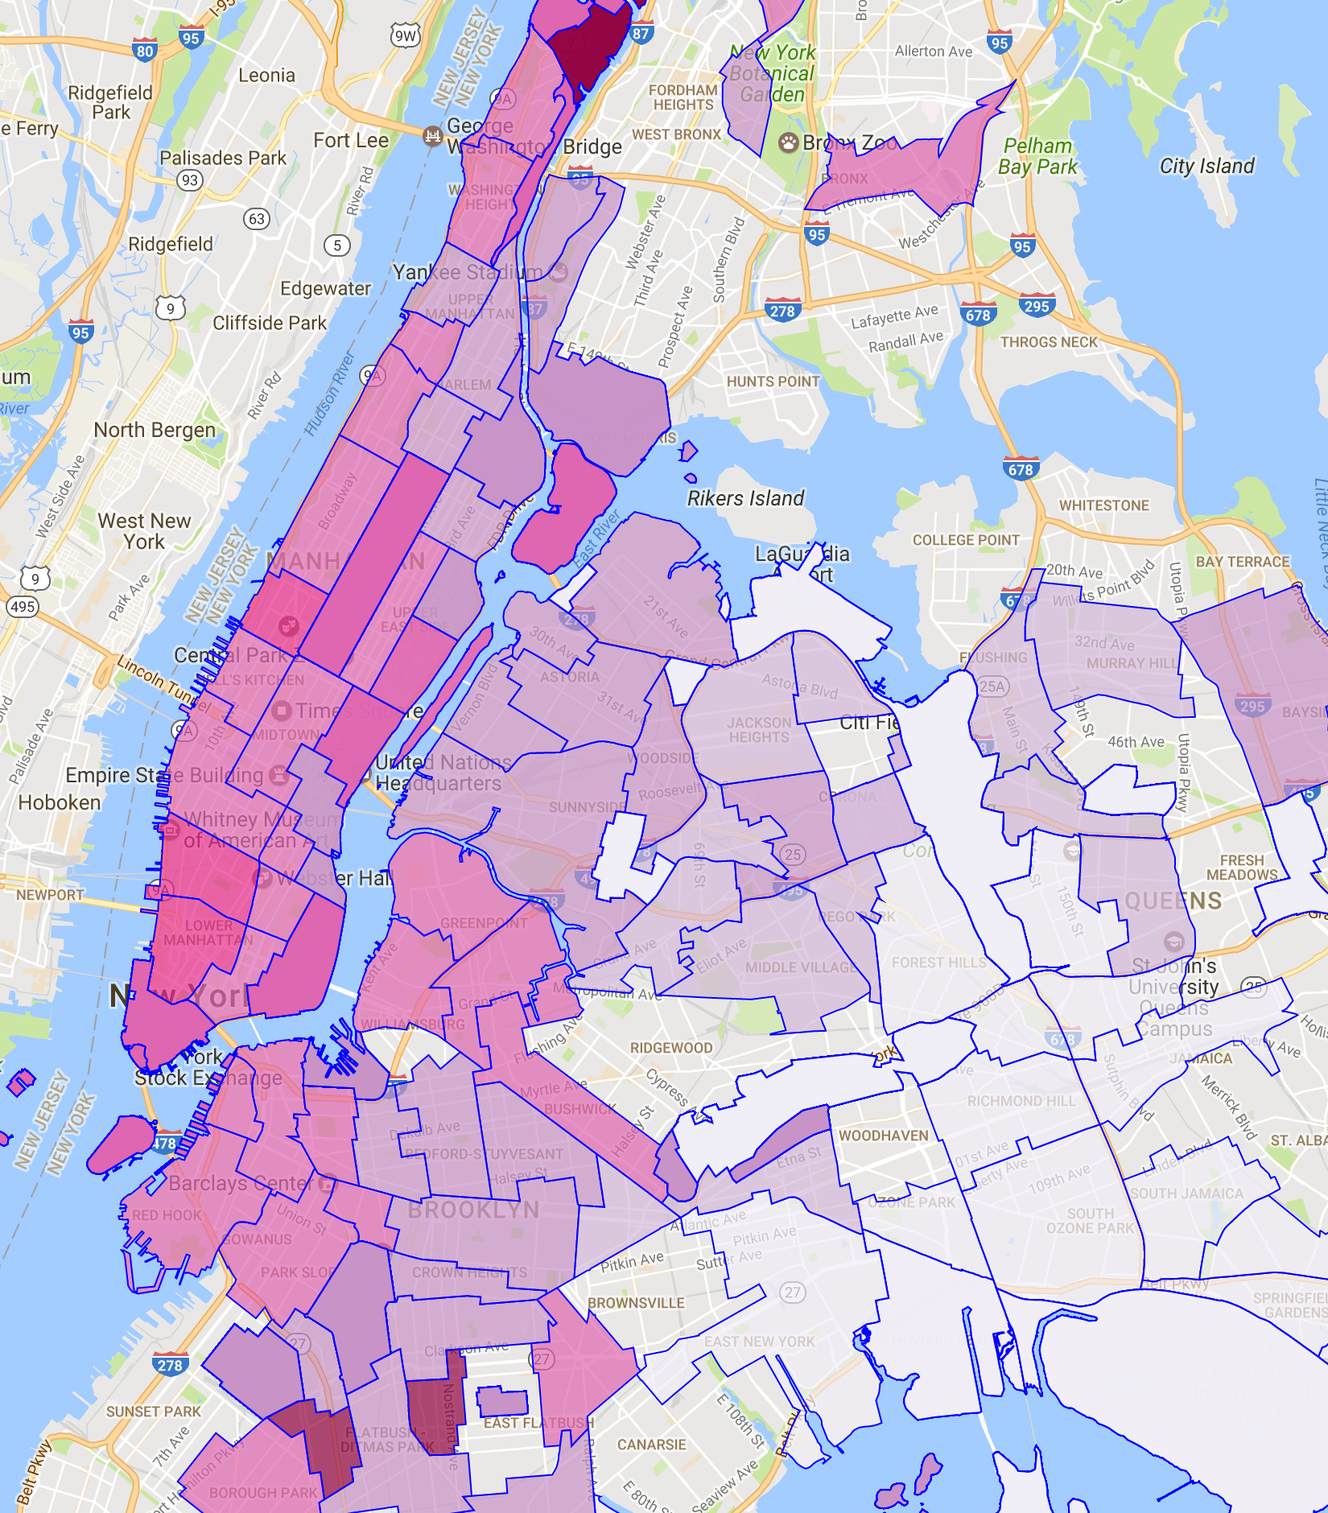
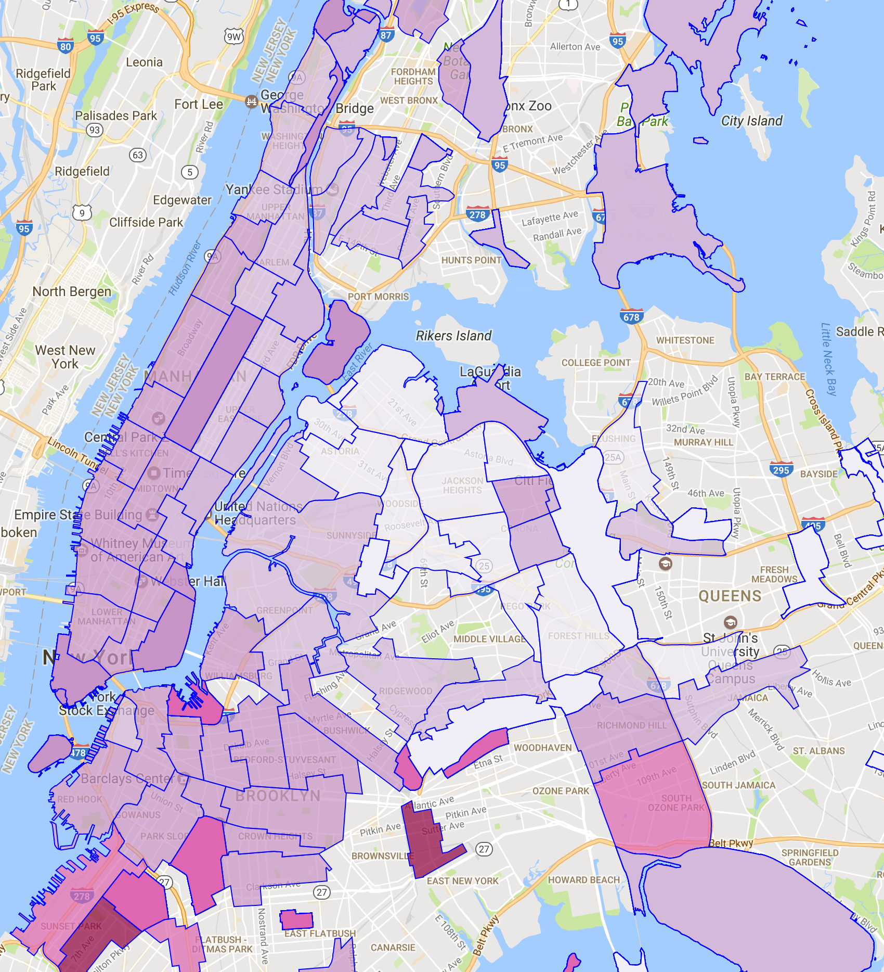
Rush-Hour Trip Time to Airports by Neighborhood
LGA
JFK

Slide 13
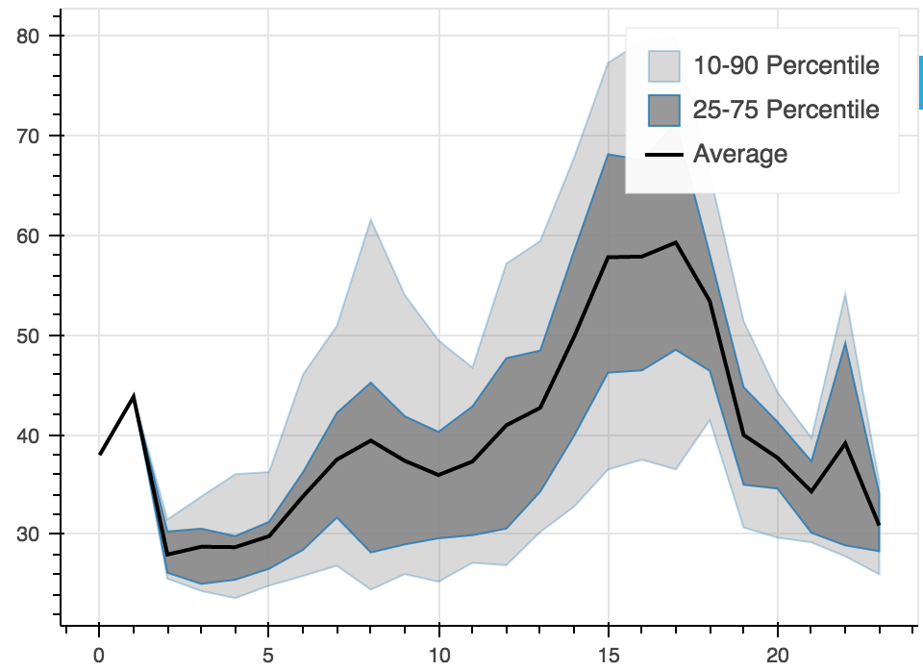
Midtown to JFK Trip Time by Hour

Slide 14
Obstacles and Further Investigations
Using packages not optimized for parallel processing in map or UDF can drastically diminish the benefit of distributed computing
External packages need to be installed in each work node
Spark lacks the functionality to efficiently process geospatial data

Slide 15
Lessons
Spark is exceptional for processing large datasets.
Knowing when to use which tool is the key to project success.

Slide 16
THANKS!
Any questions?

